Slide 1
Competence Center Microsoft: Corso .NET BASE (BSL - Application, Product Development & Testing)
Novembre 2014

Slide 2
Struttura del corso
Contenuti
Visual Studio 2013 Intro
HTML5 (base)
CSS3 / ResponsiveDesign
Canvas
WebSocket / WebWorker
JavaScript & Ajax
jQuery (base)
WebForms (cenni)
6 Days
4h on Teaching Room (15:30-19:30)
Breaks: 16:30-17:00
Sala 203
martedì 18 novembre 2014 | 15.30 -> 19.30
giovedì 20 novembre 2014 | 15.30 -> 19.30
martedì 25 novembre 2014 | 15.30 -> 19.30
giovedì 27 novembre 2014 | 15.30 -> 19.30
martedì 2 dicembre 2014 | 15.30 -> 19.30
giovedì 4 dicembre 2014 | 15.30 -> 19.30

Slide 3

Struttura del corso
Contenuti
Visual Studio 2013 Intro
HTML5 (base)
CSS3
Canvas
WebSocket / WebWorker
Twitter Bootstrap (as example)
JavaScript & Ajax
jQuery (base)
WebForms (cenni)
6 Days
Lavoro a casa (2-4h)
Esercizi
Ripasso Lettura tutorial / documentazione
TheQuestionmark TM ‘?’ Quarter ad ogni inizio lezione
Materiali del corso
http://gioorgi.com/series/netbase
http://www.microsoftvirtualacademy.com/training-courses/learn-html5-with-javascript-css3-jumpstart-training
@Home
Hands On !!

Slide 4
WarPlan Day4
AJAX
Basic Ajax
jQuery AJAX
Web Sockets for RealTime communication
Offline support via
localStorage API
ApplicationCache API (cenni)
Drag&Drop
Canvas Programming
On JavaScript Libraries

Slide 5
Ajax: definizione
Ajax
Asynchronous JavaScript and XML
Nato nel 1999 con ActiveX Microsoft Microsoft created the XMLHTTP ActiveX control in Internet Explorer 5, which was later adopted by Mozilla, Safari, Opera and other browsers as the native XMLHttpRequest object.
Esploso come fenomeno nel 2004 (GMail)
JQuery nasce nel 2006, ed è usata da quasi il 30% dei siti AJAX
(fonte: Wikipedia)

Slide 6
Ajax: Pro
In many cases, related pages on a website consist of much content that is common between them. Using traditional methods, that content would have to be reloaded on every request. However, using Ajax, a web application can request only the content that needs to be updated, thus drastically reducing bandwidth usage and load time.
The use of asynchronous requests allows the client's Web browser UI to be more interactive and to respond quickly to inputs, and sections of pages can also be reloaded individually. Users may perceive the application to be faster or more responsive, even if the application has not changed on the server side.
The use of Ajax can reduce connections to the server, since scripts and style sheets only have to be requested once.
State can be maintained throughout a Web site. JavaScript variables will persist because the main container page need not be reloaded.

Slide 7
Ajax: Contro
More complex
Ajax-powered interfaces may dramatically increase the number of user-generated requests to web servers and their back-ends (i.e. databases). This can lead to additional hardware needs.
Like other web technologies, Ajax has its own set of vulnerabilities that developers must address. Developers familiar with other web technologies may have to learn new testing and coding methods to write secure Ajax applications.
Accessibility is limited (JavaScript execution needed)
Serch engine indexing is impossibile, so you must expose data in onther way
HTML Navigation must be reimplemented: back/forward and bookmarking

Slide 8
Ajax: manual way
<body>
Here Ajax Loading:
<pre id="myDiv">Here report</pre>
Push F12 and reload the page to activate debugger
<script>
var testme = function () {
// window.ActiveXObject("Microsoft.XMLHTTP");
var xmlhttp = new window.XMLHttpRequest();
xmlhttp.onreadystatechange = function () {
if (xmlhttp.readyState == 4 && xmlhttp.status == 200) {
document.getElementById("myDiv").innerHTML = xmlhttp.responseText;
}
}
debugger;
xmlhttp.open("GET", "eva_series.txt", true);
xmlhttp.send();
}
</script>

Slide 9
Ajax: so what?
// Create the request object
// (This is still attached to ajaxSettings for backward compatibility)
jQuery.ajaxSettings.xhr = window.ActiveXObject ?
/* Microsoft failed to properly
* implement the XMLHttpRequest in IE7 (can't request local files),
* so we use the ActiveXObject when it is available
* Additionally XMLHttpRequest can be disabled in IE7/IE8 so
* we need a fallback.
*/
function() {
return !this.isLocal && createStandardXHR() || createActiveXHR();
} :
// For all other browsers, use the standard XMLHttpRequest object
createStandardXHR;

Slide 10
Ajax Easy: Caricamento di frammenti HTML
$("#o").load("./frammentoHtml.html");
Esempio con selettore:
$("#o").load("./frammentoHtml.html#div b");
$("#o").load("./frammentoHtml.html#div p");
Carica tutti i paragrafi dentro tutti i div
Vedi esempi ajax dentro progetto day4

Slide 11
Ajax: Full Power Examples
$.ajax({ type: "POST", url: "some.php", data: "name=John&location=Boston", success: function(msg){ alert( "Data Saved: " + msg ); } });

Slide 12
Ajax: Full Power Examples
$.ajax({ type: "GET", url: "test.js", dataType: "script" });
Carica il file test.js e lo esegue

Slide 13
Esempio Ajax + Json + Struts2
JQuery fornisce il metodo
$.getJSON( String url,
Map dataToSend,
Function callback )
per fare richieste in GET e ottenere risultati JSON
Esempio “Json”:
http://localhost/jQueryTrainer/
Hands On 4

Slide 14
Ending Words:Plugin da considerare
JQuery UI: http://jqueryui.com/
Supporta dialog, tab, etc
Possibilità di supportare temi
Validation Plugin: http://plugins.jquery.com/project/validate http://docs.jquery.com/Plugins/Validation
Dichiarativo
Supporta validazione lato server e lato client
LiveQuery: http://plugins.jquery.com/project/livequery
JQuery Lint http://james.padolsey.com/javascript/jquery-lint/

Slide 15
WebSocket!
Ajax è mono-direzionale
WebSockets is a technology, based on the ws protocol, that makes it possible to establish a continuous full-duplex connection stream between a client and a server. A typical websocket client would be a user's browser, but the protocol is platform independent.
Seems supported only by IIS 8+ so little use for the meantime
Vedi esempi day4/5-websocket.html

Slide 16
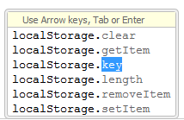
Local Storage
HTML local storage provides two objects for storing data on the client:
window.localStorage Memorizza i dati nel local storage sotto forma di oggetti chiave->valore
code.sessionStorage Memorizza i dati per una sessione, alla chiusura della finestra i dati sono persi
Metodi disponibili:
Supportato solo da IE8 in poi

Slide 17
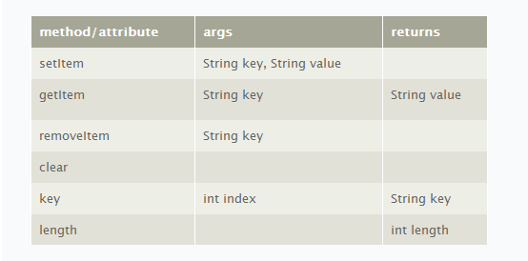
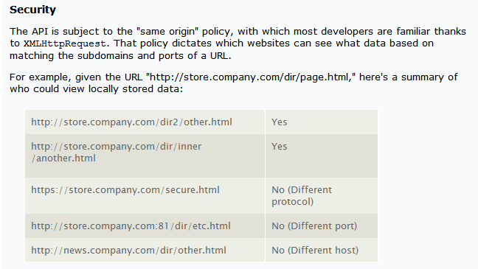
Local Storage API e policy di sicurezza
Dettaglio API:
Sicurezza

Slide 18
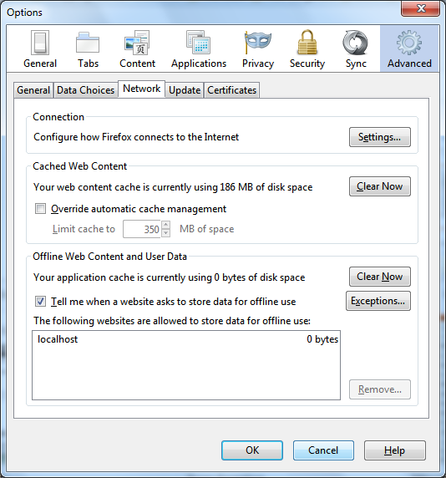
Local storage: effimero
Il local storage è ottimo come meccanismo di cache o per accessi offline mentre come storage persistente è una pessima idea poiché l'utente può cancellare inavvertitamente i dati
Inoltre il browser pone dei vincoli non indifferenti sulla quantità dei dati memorizzati
E' uno dei peggiori posti dove memorizzare dati sensibili (i.e.password)

Slide 19
Javascript API: let's moderinze
Anzi MODERNIZR http://modernizr.com/docs/
Modernizr is a small JavaScript library that detects the availability of native implementations for next-generation web technologies, i.e. features that stem from the HTML5 and CSS3 specifications. Many of these features are already implemented in at least one major browser (most of them in two or more), and what Modernizr does is, very simply, tell you whether the current browser has this feature natively implemented or not.
It tests for over 40 next-generation features, all in a matter of milliseconds
It creates a JavaScript object (named Modernizr) that contains the results of these tests as boolean properties
It adds classes to the html element that explain precisely what features are and are not natively supported
It provides a script loader so you can pull in polyfills to backfill functionality in old browsers

Slide 20
JavaScript Libraries on 2015: a moving target
React.js with Flux (a view-only library and an eventing module)
Ember.js (a full MVC framework)
Knockout.js (view-only library)
Backbone.js (full MVC framework)
Meteor (full isomorphic framework)
Mithril (full MVC framework)
Ember (full MVC framework)
Vue.js (view-only library)
Breeze.js (model-only library)
Ractive (view-only library)
From http://www.breck-mckye.com/blog/2014/12/the-state-of-javascript-in-2015/
The answer might be to eschew monolithic frameworks in favour of microlibraries

Slide 21
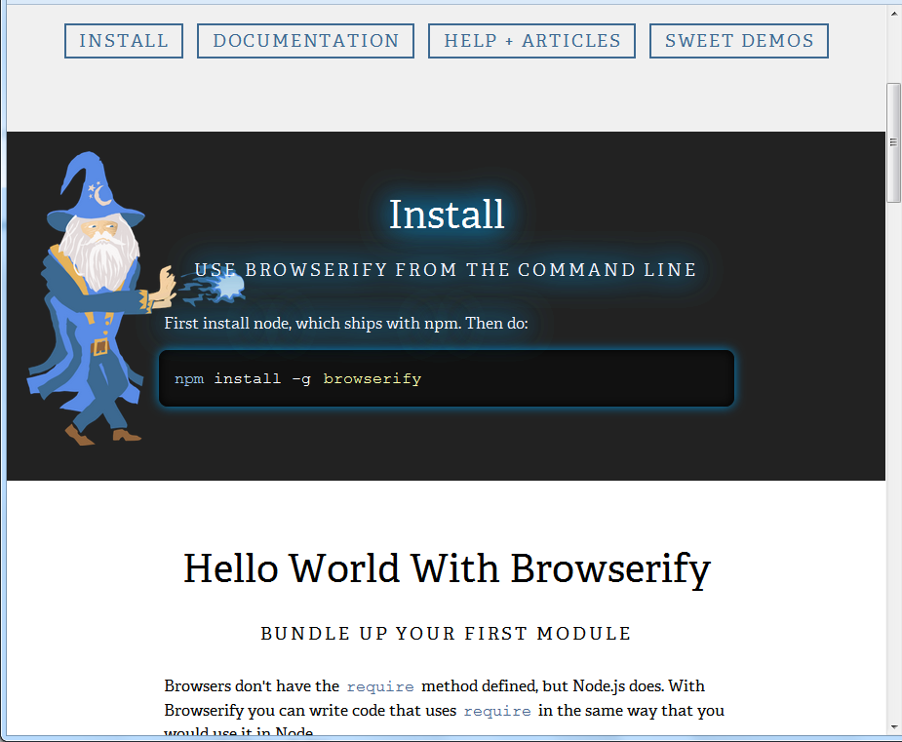
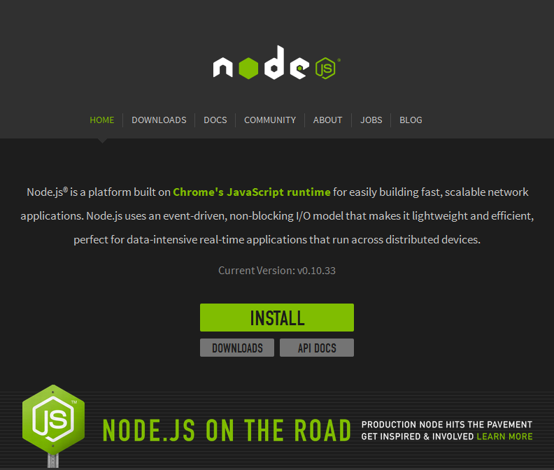
JavaScript How-to

Slide 22
Struttura del corso
Contenuti
Visual Studio 2013 Intro
HTML5 (base)
CSS3 / ResponsiveDesign
Canvas
WebSocket / WebWorker
JavaScript & Ajax
jQuery (base)
WebForms (cenni)
6 Days
4h on Teaching Room (15:30-19:30)
Breaks: 16:30-17:00
Sala 203
martedì 18 novembre 2014 | 15.30 -> 19.30
giovedì 20 novembre 2014 | 15.30 -> 19.30
martedì 25 novembre 2014 | 15.30 -> 19.30
giovedì 27 novembre 2014 | 15.30 -> 19.30
martedì 2 dicembre 2014 | 15.30 -> 19.30
giovedì 4 dicembre 2014 | 15.30 -> 19.30

Slide 23
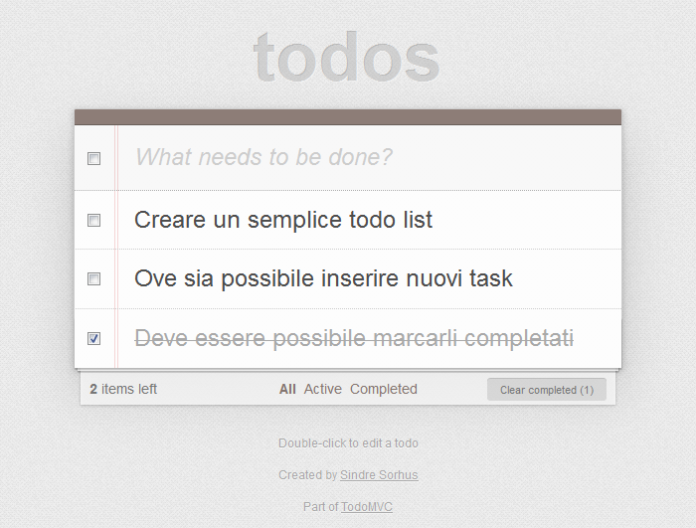
I make that: Todo list

